Slide 1
Temporal sequences
Tracking
Motion analysis

Slide 2
Demos
http://www.youtube.com/watch?v=UQypYLM1BG8
http://www.youtube.com/watch?v=Z6kzB9spqG0
http://www.youtube.com/watch?v=BUE4usv7gvs&feature=related
http://www.youtube.com/watch?v=QO7AJidmdf8

Slide 3
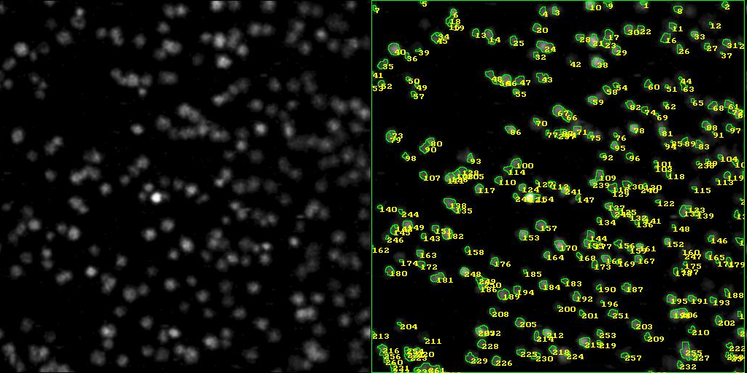
http://www.cmis.csiro.au/iap/motion/Pics/comb0001.jpg

Slide 4


Problems with detection

Slide 5
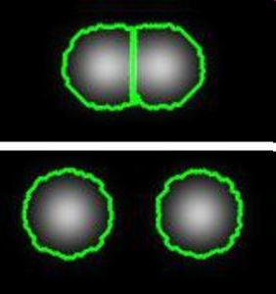
Problems with segmentation

Slide 6
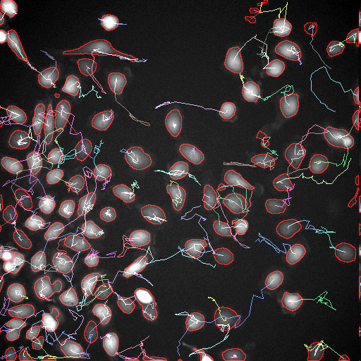
Visualisation
http://www.liacs.nl/~kyan/IMAGES/tracked_sample.gif

Slide 7
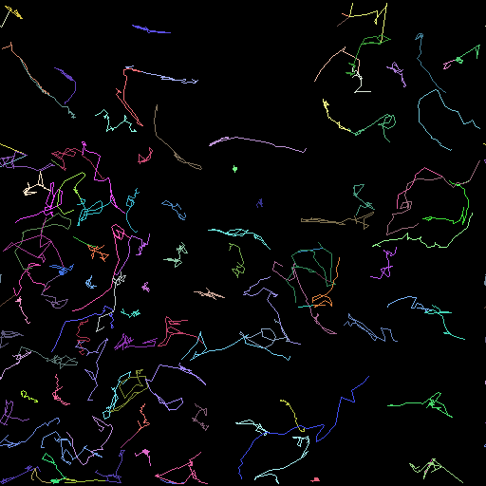
Visualisation

Slide 8
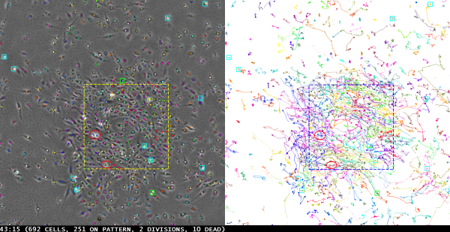
Visualisation

Slide 9
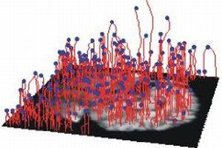
Visualisation

Slide 10
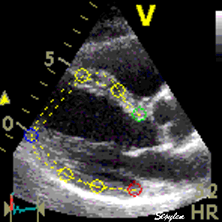

Slide 11
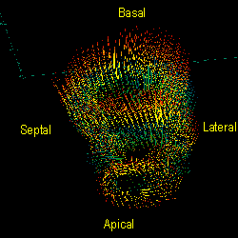

Slide 12
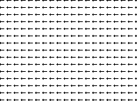

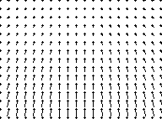
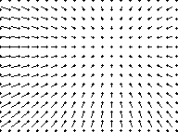
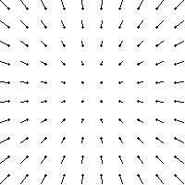
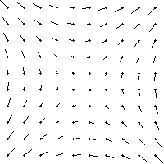
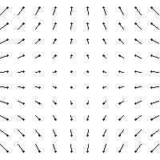
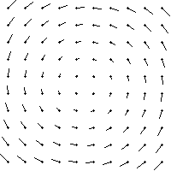
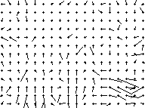
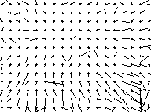
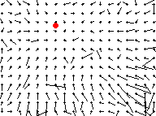
Vector (flow) fields

Slide 13
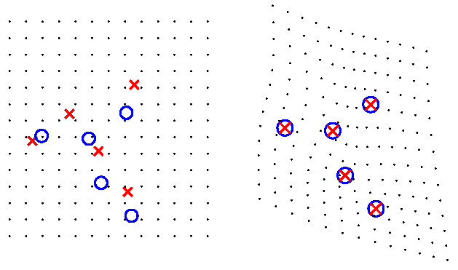
Tracking via registration
(elastic matching using thin plate splines)

Slide 14
Cell tracking software
http://www.mosaic.ethz.ch/Downloads/matlabtracker

